Slide 1
Supply
The quantity supplied of any good is the amount that sellers are willing and able to sell

Slide 2
Law of Supply
Other things being equal quantity supplied of good rises when price of good rises
there exists a direct relation between quantity supplied and the price

Slide 3
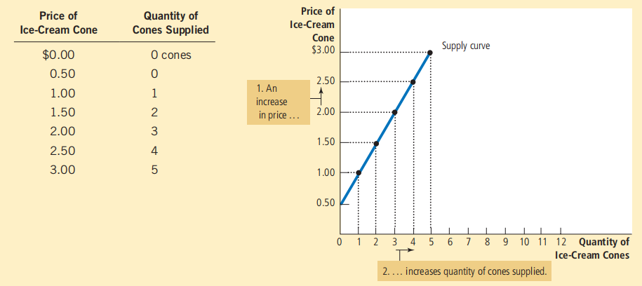
Supply Curve and schedule

Slide 4
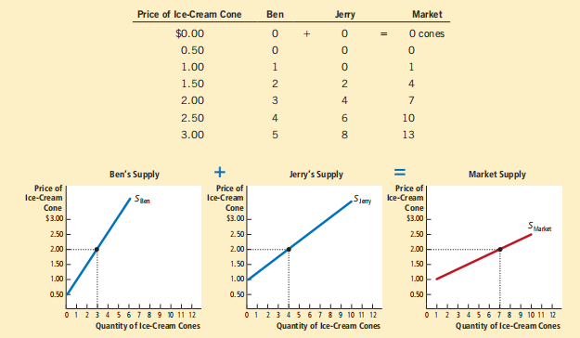
Market Supply

Slide 5
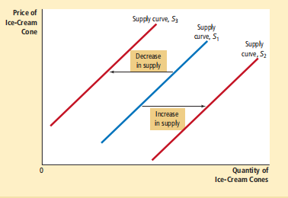
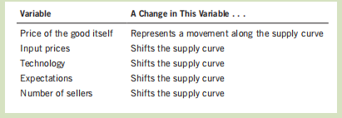
Factors influencing Supply

Slide 6
Supply and demand together
equilibrium
  a situation in which the market price has reached the level at which quantity supplied equals quantity demanded
equilibrium price
  the price that balances quantity supplied and quantity demanded
equilibrium quantity
  the quantity supplied and the quantity demanded at the equilibrium price
surplus
  a situation in which quantity supplied is greater than quantity demanded

Slide 7
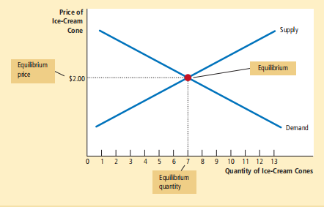
Supply and demand together
The equilibrium is found where the supply and demand curves intersect. At the equilibrium price, the quantity supplied equals the quantity demanded. Here the equilibrium price is $2.00: At this price, 7 ice-cream cones are supplied and 7 ice-cream cones are demanded.

Slide 8
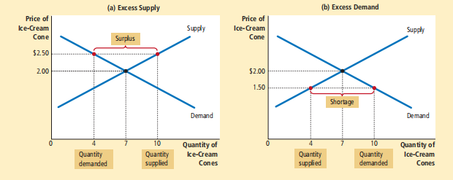
Shortage and surplus

Slide 9
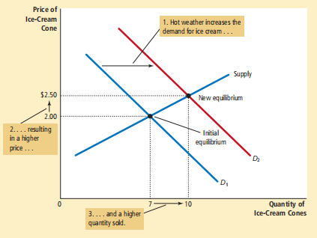
Surplus

Slide 10
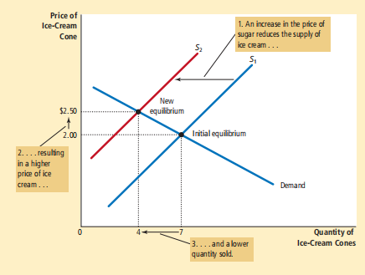
Deficit

Slide 11
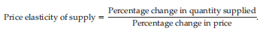
Price elasticity of supply

Slide 12
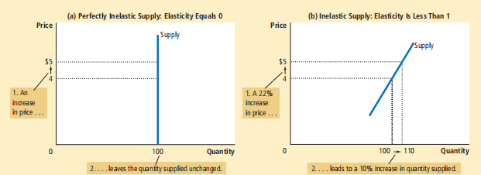

Slide 13
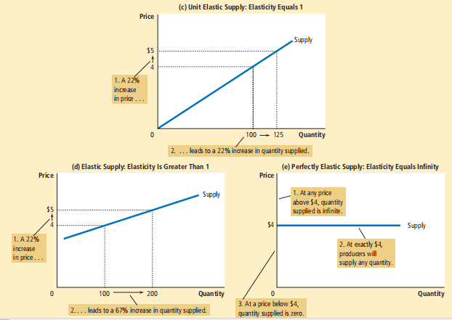

Slide 14
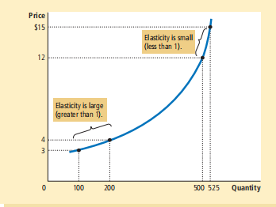
Different Elasticities of a Supply curve

Slide 15
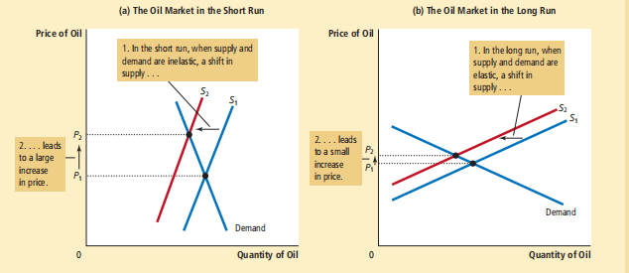
Short run and long run Supply curve

